Slide 1
Build a big data pipeline
Marinee

Slide 2
Index
Why big data? Why ML/DL?
Basic arrangements(Context of ML/DL, Distributed System)
Whole Structure
User Interface
Data Collect(Lake)
Distributed Learning with Spark & Hadoop(Super resolution)
Serving

Slide 3
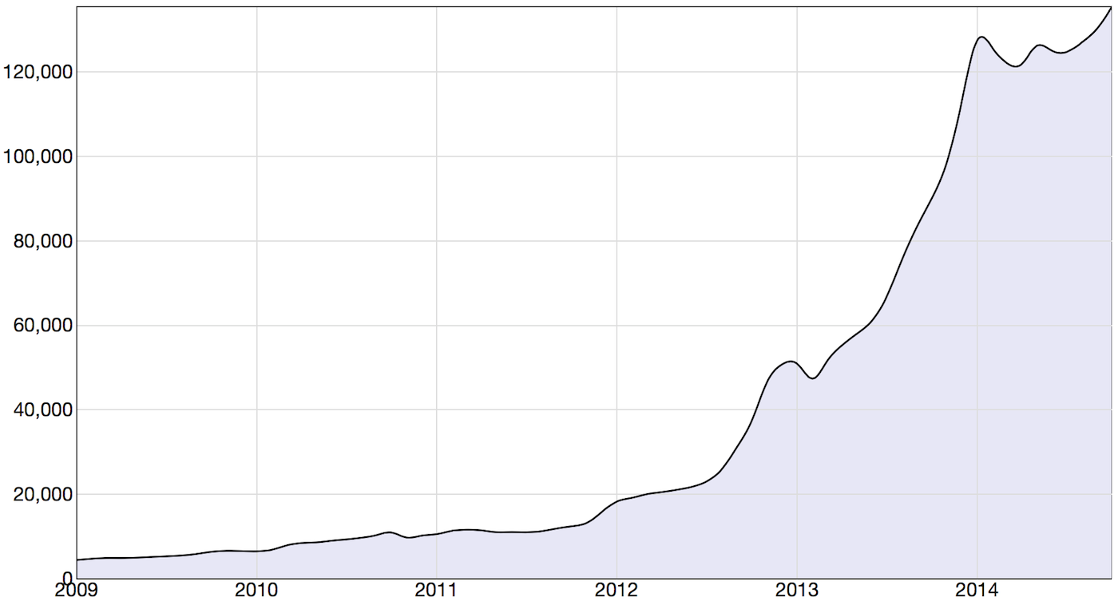
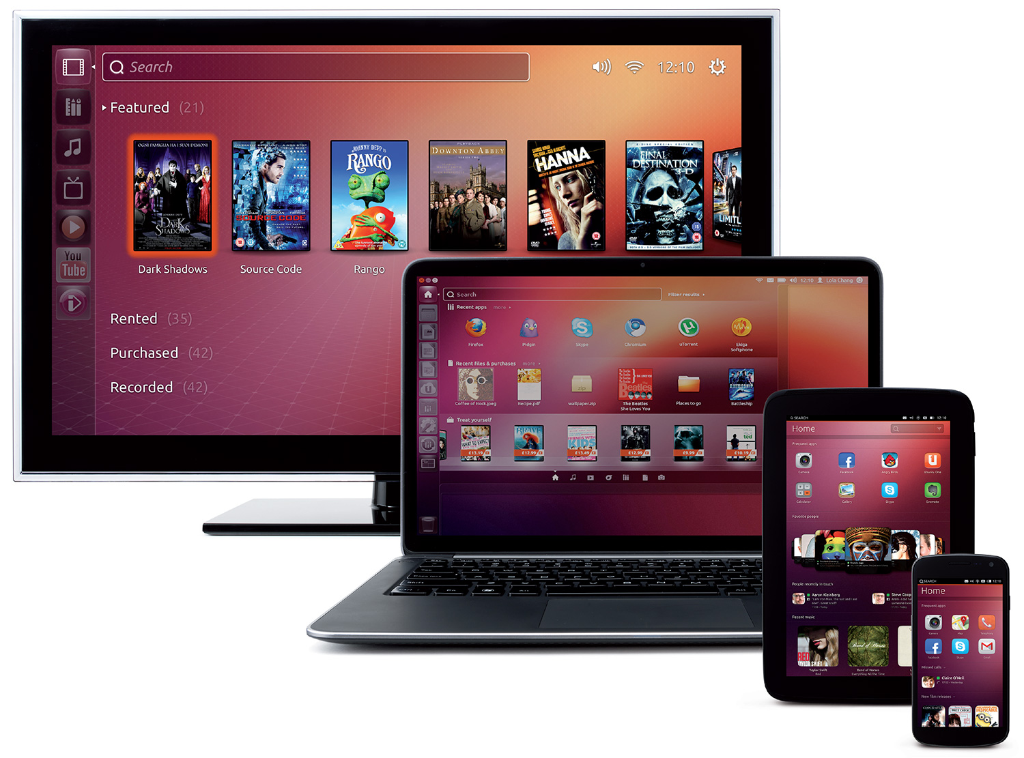
Why big data? Why ML/DL?

Slide 4
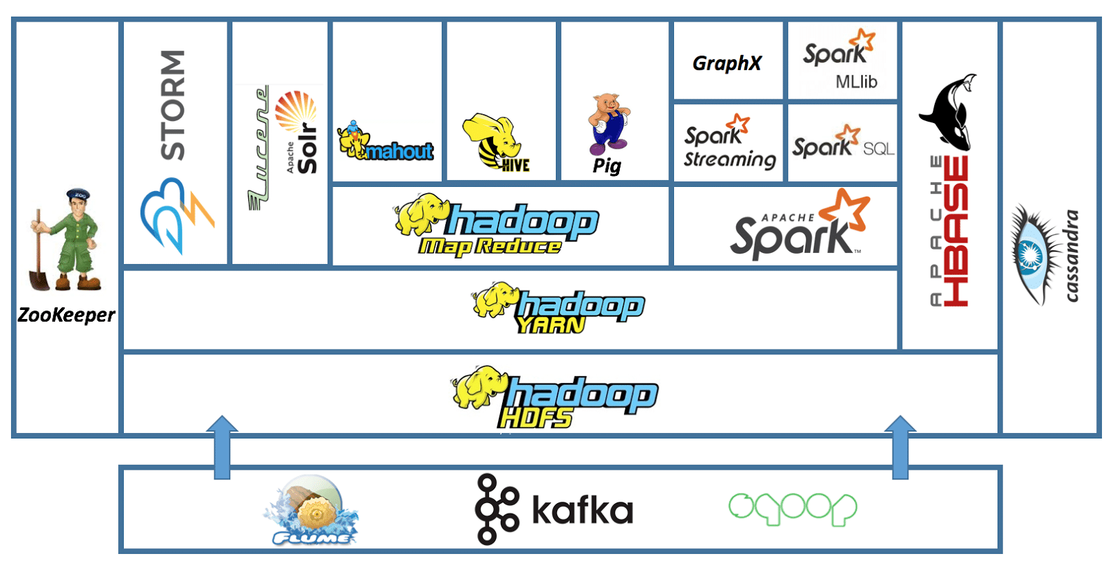
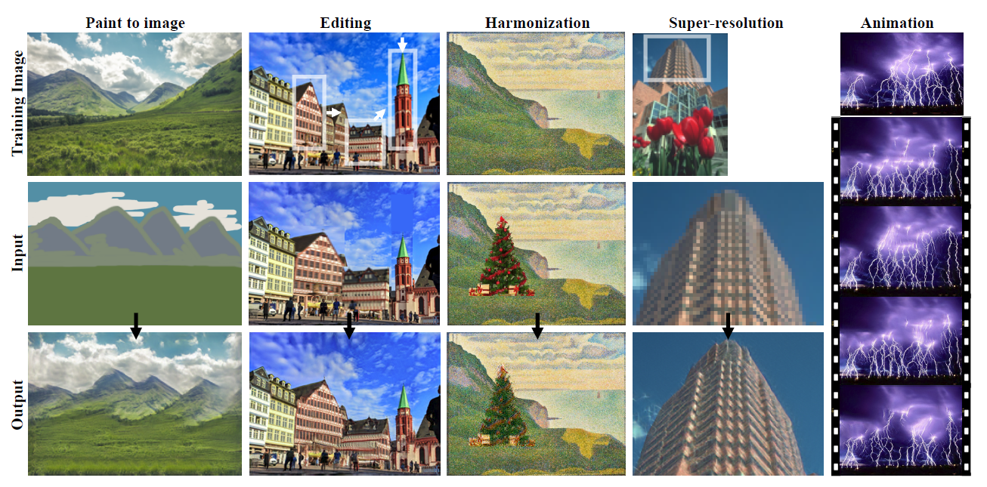
Basic arrangements
Distributed System
ML/DL

Slide 5
Whole Structure
Flume?
Spark?
Pretrained Model
Apache, Nginx?
UI
Image
Classification
Data
Collect
Distributed
Training
Serving
Output
Super Resolution
Generative model

Slide 6
User Interface
Flume?
Spark?
Pretrained Model
Apache, Nginx?
UI
Image
Classification
Data
Collect
Distributed
Training
Serving
Output
Super Resolution
Generative model
User
Low resolution
Application
High resolution

Slide 7
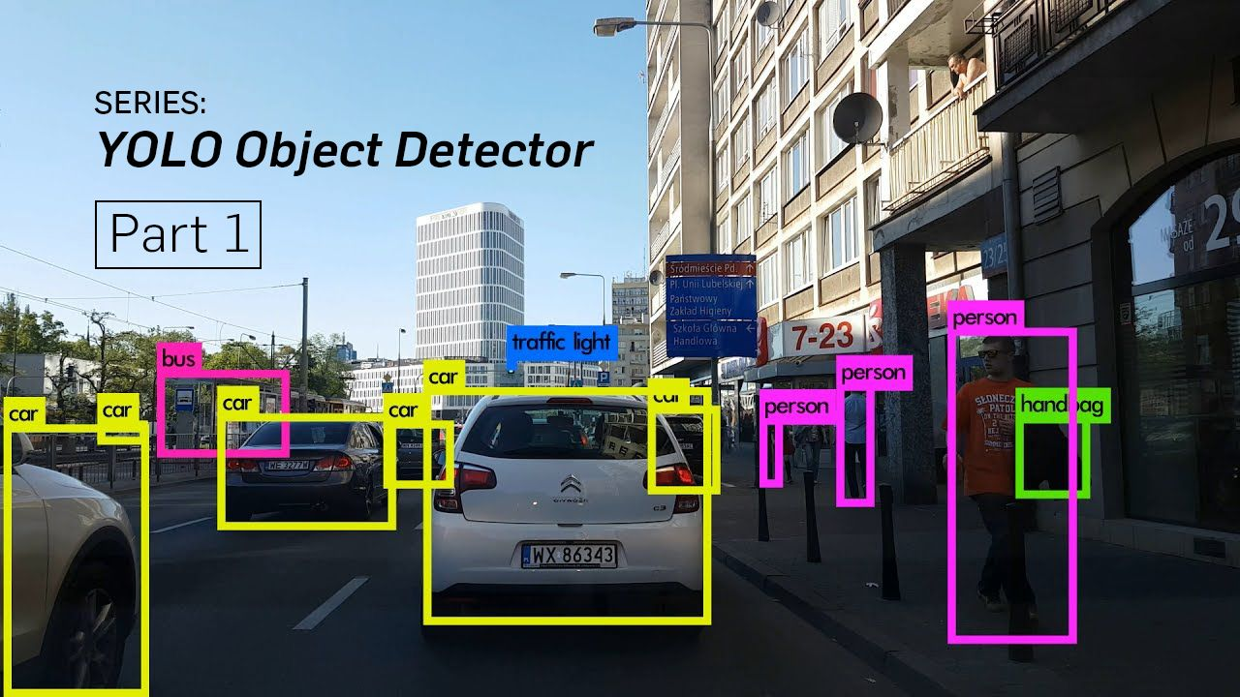
Classification
Flume?
Spark?
Pretrained Model
Apache, Nginx?
UI
Image
Classification
Data
Collect
Distributed
Training
Serving
Output
Super Resolution
Generative model

Slide 8
Data Collect
Collector
(Flume?)
Storage
(AWS?)
High resolution Image
Some kinds of rules
(Categorical, others)
Notes:
http://taewan.kim/post/flume_images/
https://flume.apache.org/FlumeUserGuide.html

Slide 9
Distributed Training
spark-summit.org/2016/scheduleLarge-Scale Deep Learning with TensorFlow (Jeff Dean)
slide
video
AI: The New Electricity (Andrew Ng)
Large Scale Multimedia Data Intelligence And Analysis On Spark (Baidu)
slide
video
Scaling Machine Learning To Billions Of Parameters (Yahoo)
slide
video
CaffeOnSpark: Deep Learning On Spark Cluster (Yahoo)
slide
video
Scalable Deep Learning in Baidu
slide
video

Slide 10
Serving
Nginx
Firebase

