Slide 1
Do you know DB?
Baekjoon Best Conference
김준호 (a.k.a Cono)

Slide 2
Contents
What Is Database?
File And Index Management
B+ Tree
Disk Space Management
Buffer Management
Relational Algebra
Query Optimization
SQL Client

Slide 3
What Is Database?
Save
&
Find
Quickly

Slide 4
What Is Database?
Column
↓
Table
Name | Height | Weight
Cono | 168 | 57
Kakao Friends | 190 | 60
Windforces | 186 | 68
Gidong | 68 | 186
Record →
This called Relational Database

Slide 5
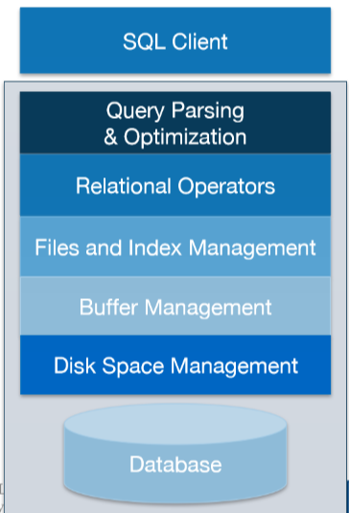
Database hierarchy

Slide 6
Database hierarchy
We start here

Slide 7
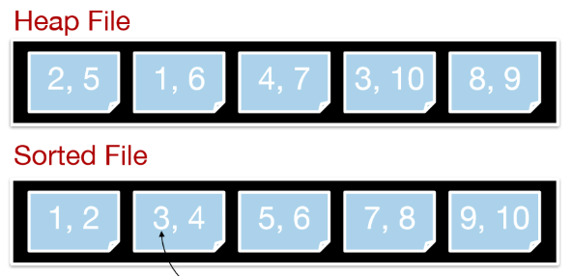
File And Index Management

Slide 8
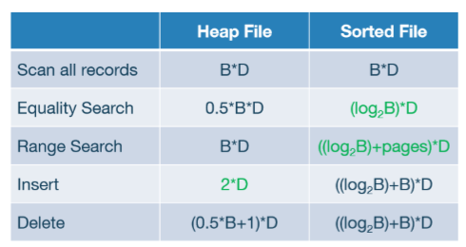
File And Index Management

Slide 9
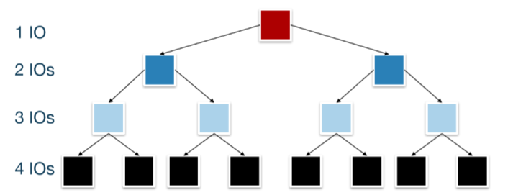
File And Index Management
Answer is… “Balanced Binary Search Tree”

Slide 10
B+ tree

Slide 11
B+ tree

Slide 12
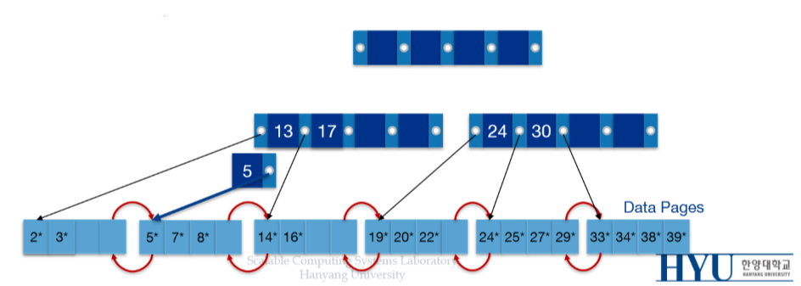
B+ tree

Slide 13
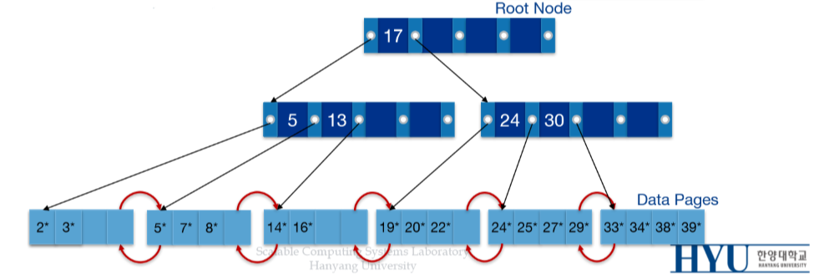
B+ tree

Slide 14
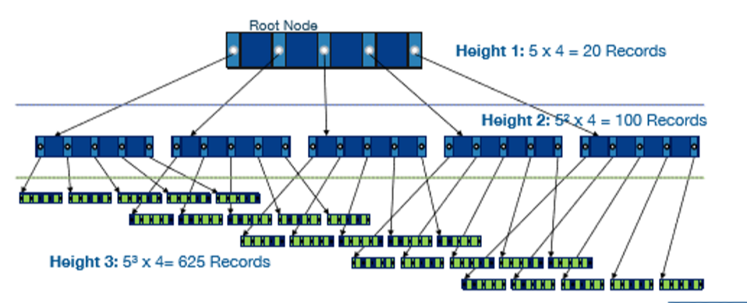
B+ tree
Thinking about B+ tree with 256 pointers…

Slide 15
Thinking About Memory …
1 page = 4 KB
1,000,000 pages = 4,000,000 KB = 390.625 MB
10,000,000 pages = 40,000,000 KB = 3906.25 MB
Require LARGE memory!

Slide 16
Thinking About Memory …
RAM is expensive!

Slide 17
Thinking About Memory …
Use HDD

Slide 18
Database hierarchy
We are here

Slide 19
Disk Space Management
Each node is page, and page is stored in part of file!

Slide 20
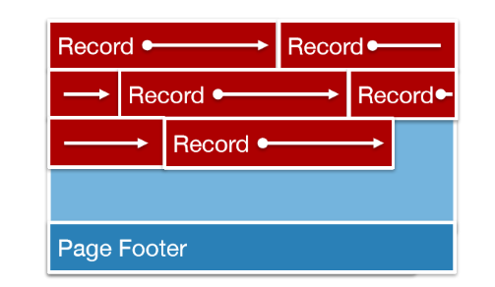
Disk Space Management

Slide 21
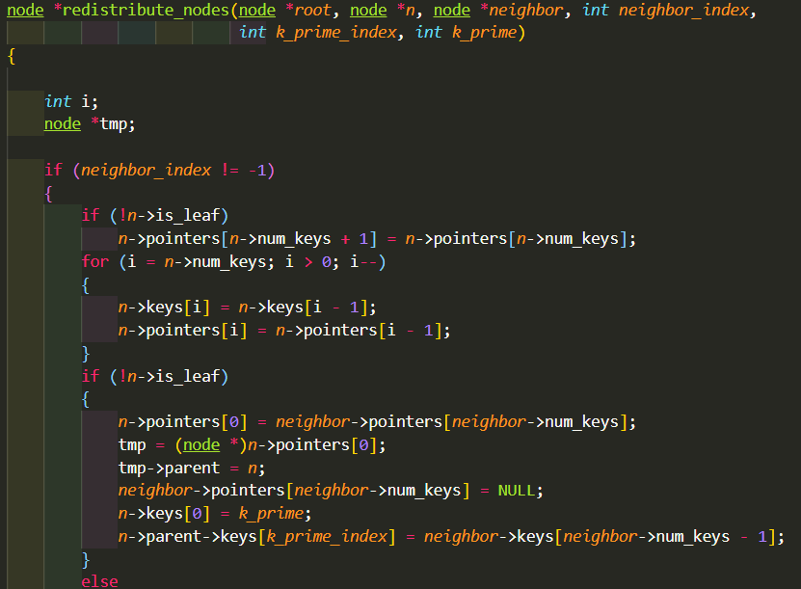
Disk Space Management

Slide 22
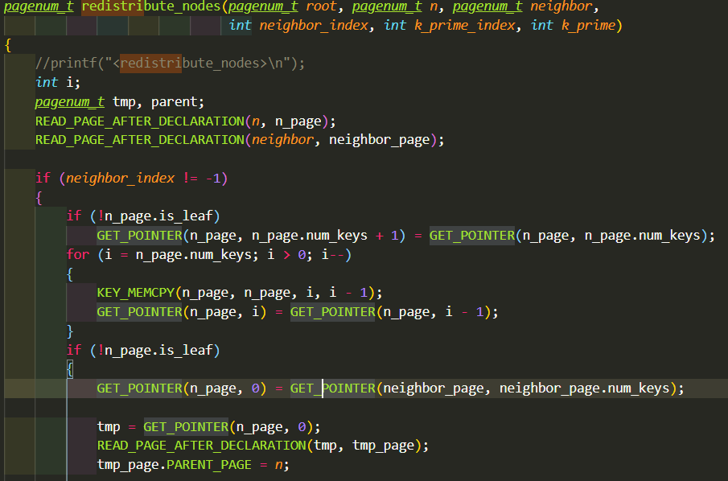
Disk Space Management

Slide 23
Disk Space Management

Slide 24
Thinking About File IO…
cin.tie(nullptr);
ios::sync_with_stdio(false);
endl X
‘\n’ O
BufferedReader br = new BufferedReader(new…);
sys.stdin.readline()
sys.stdout.write()
File IO is SLOW

Slide 25
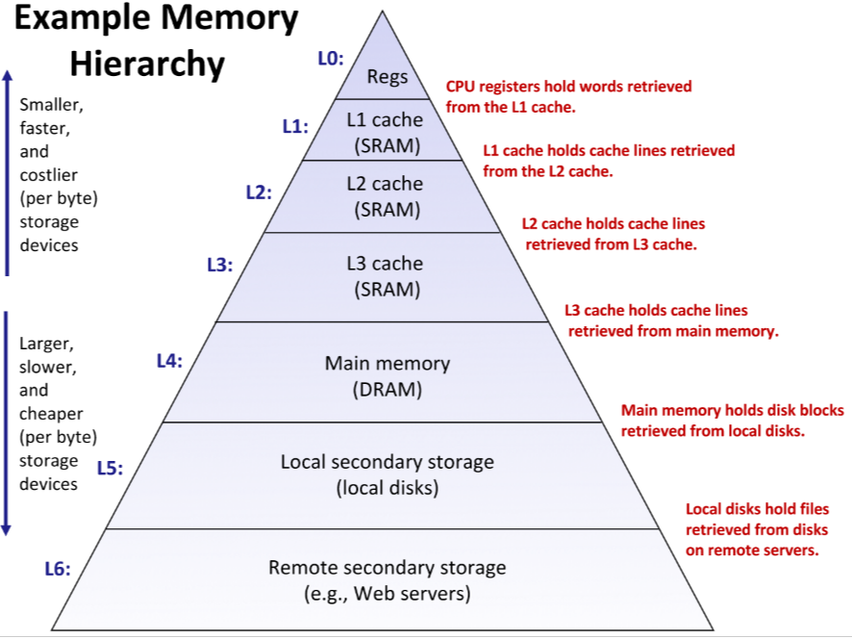
Cache Hit?

Slide 26
Cache Hit?

Slide 27
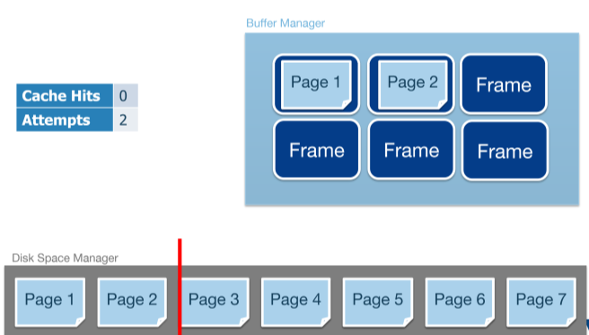
Page Hit!

Slide 28
Database Hierarchy
We are here

Slide 29
Buffer Manager
0
1
2
3
4
5
6
7
8
9
Want to read page?
First place it on the buffer!
page

Slide 30
Buffer Manager
0
page
2
3
4
5
6
7
8
9
Want to read page?
First place it on the buffer!
page

Slide 31
Buffer Manager
0
page
2
3
4
5
6
7
8
9
RAM is faster than HDD!
Page hit → Good performance
page

Slide 32
Hash Collision
0
1
2
3
4
5
6
7
8
9
Hash function f(x) = x % 10
func1()
func2()
Page 3, Buffer 3, write
Page 13, Buffer 3, read

Slide 33
Hash Collision
0
1
2
3
4
5
6
7
8
9
Pin: Using now
Dirty: Written

Slide 34
Page Replacement
page
page
page
page
page
page
page
page
page
page
When all buffers contain page?
LRU, MRU, HASH, …
New

Slide 35
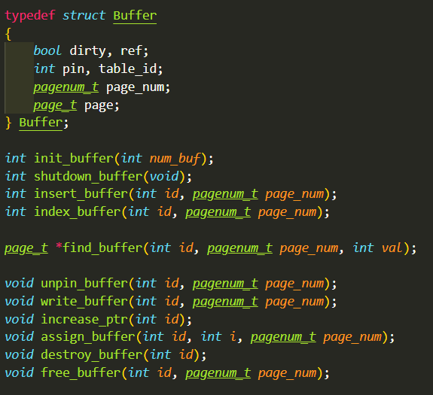
Buffer Manager

Slide 36
Database Hierarchy
We are here

Slide 37
Relational Operator
Name | Height | Weight
Cono | 168 | 57
Kakao Friends | 190 | 60
Windforces | 186 | 68
R
σ: Selection

Slide 38
Relational Operator
Name | Height | Weight
Cono | 168 | 57
Kakao Friends | 190 | 60
Windforces | 186 | 68
R
σ_{height>180} (R) ?

Slide 39
Relational Operator
Name | Height | Weight
Kakao Friends | 190 | 60
Windforces | 186 | 68
R
σ_{height>180} (R) ?

Slide 40
Relational Operator
Name | Height | Weight
Cono | 168 | 57
Kakao Friends | 190 | 60
Windforces | 186 | 68
R
π: Projection

Slide 41
Relational Operator
Name | Height | Weight
Cono | 168 | 57
Kakao Friends | 190 | 60
Windforces | 186 | 68
R
π_{name, height}(R) ?

Slide 42
Relational Operator
Name | Height
Cono | 168
Kakao Friends | 190
Windforces | 186
R
π_{name, height}(R) ?

Slide 43
Relational Operator
Name | Height | Weight
Cono | 168 | 57
Kakao Friends | 190 | 60
Windforces | 186 | 68
R
Name | Algorithm
Cono | D0
Kakao Friends | A+
Gidong | F
S
⟕: Join

Slide 44
Relational Operator
Name | Height | Weight
Cono | 168 | 57
Kakao Friends | 190 | 60
Windforces | 186 | 68
R
Name | Algorithm
Cono | D0
Kakao Friends | A+
Gidong | F
S
R ⟕_{R.name=S.name} S ?

Slide 45
Relational Operator
Name | Height | Weight | Algorithm
Cono | 168 | 57 | D0
Kakao Friends | 190 | 60 | A+
R ⟕_{R.name=S.name} S ?

Slide 46
Relational Algebra
π_{S.name, R.height}(R ⟕_{R.name=S.name} S)

Slide 47
Query
π_{name, height}(σ_{R.height>180}(R ⟕_{R.name=S.name}S))
Projection, Selection, Join …

Slide 48
Query cost
?
50 records per page
Memory allows 2 pages
R table: id, height
S table: id, weight
300 pages ≒ 15,000 records
100 pages ≒ 5,000 records
π_{S.weight} (σ_{R.height=180∧S.weight>50}(R ⟕_{R.id=S.id}S))

Slide 49
Query cost
?
50 records per page
Memory allows 2 pages
R table: id, height
S table: id, weight
300 pages ≒ 15,000 records
100 pages ≒ 5,000 records
π_{S.weight} (σ_{R.height=180∧S.weight>50}(R ⟕_{R.id=S.id}S))

Slide 50
Query cost
50 records per page
Memory allows 2 pages
R table: id, height
S table: id, weight
300 pages ≒ 15,000 records
100 pages ≒ 5,000 records
π_{S.weight} (σ_{R.height=180∧S.weight>50}(R ⟕_{R.id=S.id}S))

Slide 51
Query cost
π_{S.weight} (σ_{R.height=180∧S.weight>50}(R ⟕_{R.id=S.id}S))
R ⟕_{R.id=S.id}S
Join’s cost is important!

Slide 52
R: 300 pages ≒ 15,000 records
S: 100 pages ≒ 5,000 records
Query Cost
Page 1
Record 1
Record 2
.
.
.
Record 50
Page 2
Page 3
Page 100
R’s one page

Slide 53
R: 300 pages ≒ 15,000 records
S: 100 pages ≒ 5,000 records
Query Cost
Page 1
Record 1
Record 2
.
.
.
Record 50
Page 2
Page 3
Page 100
Page IO: 300 + 15000*100
= 1,500,300

Slide 54
Query Cost
?
Wait…
Page IO depends on Record * Page ??

Slide 55
Query Cost
Same?
R ⟕_{R.id=S.id} S
S ⟕_{R.id=S.id} R

Slide 56
R: 300 pages ≒ 15,000 records
S: 100 pages ≒ 5,000 records
Query Cost
Page 1
Record 1
Record 2
.
.
.
Record 50
Page 2
Page 3
Page 300
Page IO: 100 + 5000*300
= 1,500,100

Slide 57
Query Cost
1,500,300 → 1,500,100
Just change join’s order…
Page IO reduced..??

Slide 58
Database Hierarchy
We are fxxking finally here

Slide 59
Query Optimization
Recall….
R table: id, height
S table: id, weight
300 pages ≒ 15,000 records
100 pages ≒ 5,000 records
π_{S.weight} (σ_{R.height=180∧S.weight>50}(R ⟕_{R.id=S.id}S))

Slide 60
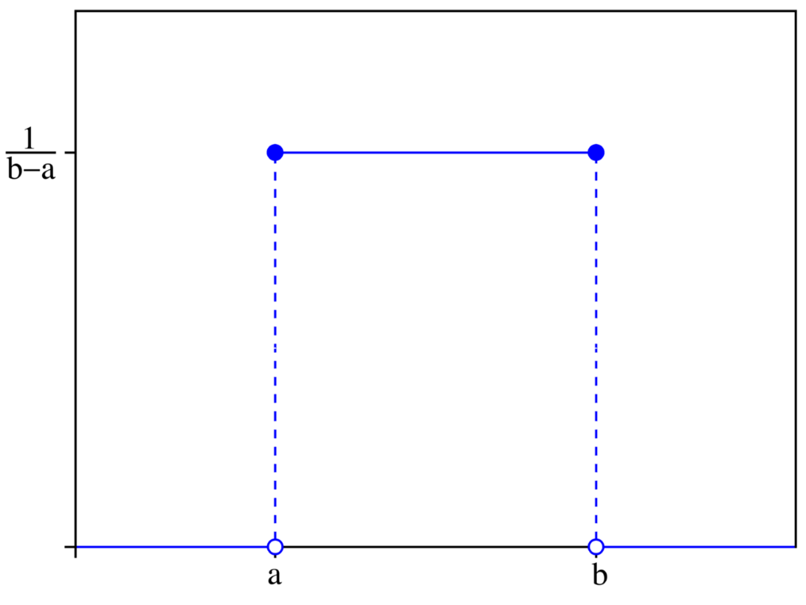
Query Optimization
Recall….
π_{S.weight} (σ_{R.height=180∧S.weight>50}(R ⟕_{R.id=S.id}S))
Suppose uniform distribution
100 < height <= 200
0 < weight <= 100

Slide 61
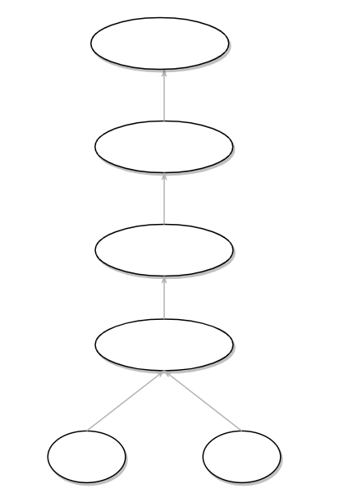
Query Optimization
R: 300 pages ≒ 15,000 records
S: 100 pages ≒ 5,000 records
π_{weight}
σ_{height=180}
Page IO: 300 + 15000*100
= 1,500,300
σ_{weight>50}
⟕_{R.id=S.id}
R
S

Slide 62
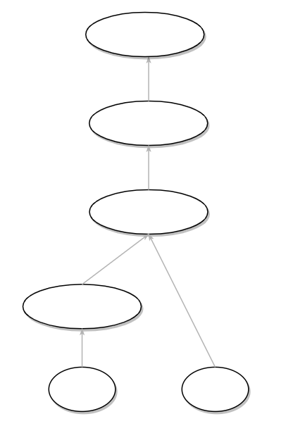
Query Optimization
R: 300 pages ≒ 15,000 records
S: 100 pages ≒ 5,000 records
π_{weight}
15,000 records
Uniform distribution
15,000 / 100 = 150
σ_{weight>50}
⟕_{R.id=S.id}
Page IO: 300 + 150*100
= 15,300
σ_{height=180}
R
S

Slide 63
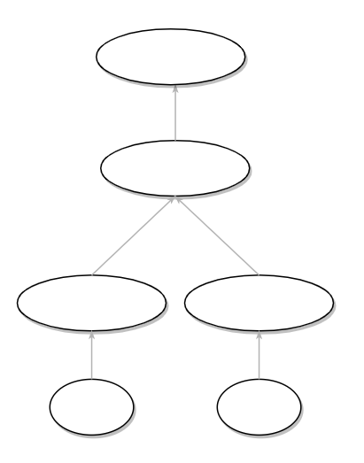
Query Optimization
R: 300 pages ≒ 15,000 records
S: 100 pages ≒ 5,000 records
π_{weight}
?
⟕_{R.id=S.id}
σ_{height=180}
σ_{weight>50}
Page IO: 300 + 150*100
= 15,300
R
S

Slide 64
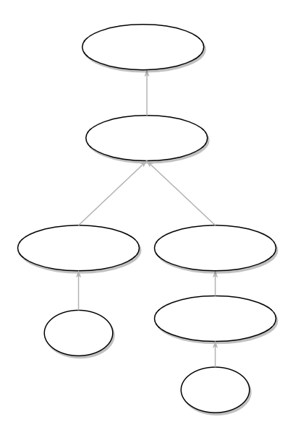
Query Optimization
R: 300 pages ≒ 15,000 records
S: 100 pages ≒ 5,000 records
π_{weight}
Read 100 pages
Uniform distribution
Write 50 pages
⟕_{R.id=S.id}
σ_{height=180}
_{Make new table}
Page IO:
100 + 50 + 300 + 150*50
= 7,950
σ_{weight>50}
R
S

Slide 65
Query Optimization
WTF???
1,500,300
→15,300
→ 7,950
… more optimization but
Hanc marginis exiguitas non caperet.

Slide 66
Database Hierarchy
The End..

Slide 67
SQL client

Slide 68
SQL client
R테이블과 S테이블을 id 기준으로 join해서 나온 테이블에서 R의 height는 180이고 S의 weight는 50 초과인 데이터들의 weight 만 뽑아서 줄래?
SELECT S.weight
FROM S, R
WHERE (
R.id = S.id and
R.height = 180 and
S.weight > 50
);
???
π_{S.weight} (σ_{R.height=180∧S.weight>50}(R ⟕_{R.id=S.id}S))

Slide 69
SQL client
π_{weight}
⟕_{R.id=S.id}
σ_{height=180}
_{Make new table}
R
σ_{weight>50}
S

Slide 70
SQL client
weight
66
67
82
61
78
92

Slide 71
Thanks For Listening
Thanks For Hyungsoo Jung too

